Slide 1


Department of Information Science and Engineering
Department of Information Science and Engineering
MACHINE LEARNING
LA-2
“STOCK MARKET PREDICTION USING ML”
Submitted by:
Soni . A -1NT19IS157
Sonal M – 1NT19IS156
Shalini N – 1NT19IS144
29-12-2022

Slide 2
Contents
Introduction
Background
Related work
Technologies and Requirements
Design
Implementation and Result
Conclusion

Slide 3
Introduction
Stock market prediction is the act of trying to determine the future value of a company stock or other financial instrument traded on a financial exchange.
The successful prediction of a stock's future price will maximize investor’s gains.
A neural networks based model have been used in predicting of the stock market.
Machine learning algorithms will work together and process complex data inputs. A machine learning model to predict Future stock market price of “Apple”.
We use LSTM technique and neural networks to predict the future stock market price of “Apple company”.

Slide 4
Introduction
The main objective to reduce the investment cost unnecessarily.
In those days, people used to invest money of the product and the outcome may not be as expected. So this leads to major drop in the company, whole share will drop down.
To overcome this, we predict the future stock market price and then invest accordingly ,which reduces the cost, time and more over enhances the growth of the company.

Slide 5
Introduction
There are 22 stock exchanges in India. But two of them are biggest.
BSE(BOMBAY STOCK EXCHANGE)-The asia’s first stock exchange and world’s tenth largest stock exchange
NSE(NATIONAL STOCK EXCHANGE)- The first exchange in the country to provide modern fully automated screen based electronic trading system.

Slide 6
Background
Data pre-processing is a technique that is used to convert the raw data into a clean data set. In other words, whenever the data is collected from different sources it is in the raw format which is not feasible for the analysis. By using this technique transform the raw data into an understanding format. Real world data is often incomplete, inconsistent and having many errors.

Slide 7
Background
LSTM(LONG SHORT-TERM MEMORY) is an artificial recurrent neural network(RNN) architecture.LSTM networks are well suited to classifying, processing and making predictions based on time series data, since there can be lags of unknown duration between important events in the time series.
Artificial neural networks(ANN) are computing systems inspired by biological neural networks that constitute animal brains. The neural network itself is not an algorithm, but rather a framework for many machine learning algorithms to work together and process complex data inputs.

Slide 8
Related work
∙ This will be useful for investors to invest in stock market based on the various factors. The
project target is to create web application that analyses previous stock data of companies and
implement these values in data mining algorithm to determine the value that particular stock will
have in near future with suitable accuracy.
∙ These predict and analyzed data can be observed by individual to know the financial status of companies and their comparisons.
∙ The main feature of the project is to generate an approximate forecasting output and create a
general idea of future values based on the previous data by generating a pattern. The scope of this
project does not exceed more than a generalized suggestion tool.

Slide 9
Technologies and Requirements
∙ Hardware Requirements
Processor i3 and above.
Ram 4gb and above.
∙ Software Requirements
Anaconda navigator as an applications wrapper hub.
∙ Libraries Required
Pandas.
Matplotlib.
Sklearn
Numpy

Slide 10
DESIGN
Long Short-Term memory is one of the most successful RNNs architectures.
Methodology of LSTM
Stage 1:
Raw Data: In this stage, the historical stock data is collected from the Google stock price and this historical data is used for the prediction of future stock prices.
Stage 2:
Data Preprocessing: The pre-processing stage involves
Data discretization: Part of data reduction but with particular importance, especially for numerical data
Data transformation: Normalization.
Data cleaning: Fill in missing values.

Slide 11
DESIGN
Stage 3:
Feature Extraction: In this layer, only the features which are to be fed to the neural network are chosen.
Stage 4:
After pre-processing is done, we spilt the dataset in to trainset and test set using “minmaxscaler”.
Minmaxscaler goes like this:-
Minmaxscaler is probably the most famous scaling algorithm and follows the following formula:-
(xi–min(x))/(max(x)–min(x))

Slide 12
IMPLEMENTATION
import pandas as pd
import matplotlib.pyplot as plt
import numpy as np
import math from sklearn.preprocessing
import MinMaxScaler from sklearn.metrics
import mean_squared_error from keras.models
import Sequential from keras.layers
import Dense, Activation from keras.layers
import LSTM

Slide 13
IMPLEMENTATION
# IMPORTING DATASET
dataset = pd.read_csv('EOD-AAPL_in.csv', usecols=[1,2,3,4])
dataset = dataset.reindex(index = dataset.index[::-1])
# TAKING DIFFERENT INDICATORS FOR PREDICTION
OHLC_avg = dataset.mean(axis = 1)
HLC_avg = dataset[['High', 'Low', 'Close']].mean(axis = 1)
close_val = dataset[['Close']]

Slide 14
IMPLEMENTATION
# PLOTTING ALL INDICATORS IN ONE PLOT
plt.plot(obs, OHLC_avg, 'r', label = 'OHLC avg')
plt.plot(obs, HLC_avg, 'b', label = 'HLC avg')
plt.plot(obs, close_val, 'g', label = 'Closing price') plt.legend(loc = 'upper right')
plt.show()
# TRAIN-TEST SPLIT
train_OHLC = int(len(OHLC_avg) * 0.75)
test_OHLC = len(OHLC_avg) - train_OHLC

Slide 15
IMPLEMENTATION
# LSTM MODEL
model = Sequential()
model.add(LSTM(32, input_shape=(1, step_size), return_sequences = True))
model.add(LSTM(16))
model.add(Dense(1))
model.add(Activation('linear'))

Slide 16
IMPLEMENTATION
# PLOT OF MAIN OHLC VALUES, TRAIN PREDICTIONS AND TEST PREDICTIONS
plt.plot(OHLC_avg, 'g', label = 'original dataset')
plt.plot(trainPredictPlot, 'r', label = 'training set')
plt.plot(testPredictPlot, 'b', label = 'predicted stock price/test set')
plt.legend(loc = 'upper right')
plt.xlabel('Time in Days')
plt.ylabel('OHLC Value of Apple Stocks')
plt.show() print("Last Day Value:", np.asscalar(last_val))
print("Next Day Value:", np.asscalar(last_val*next_val))

Slide 17
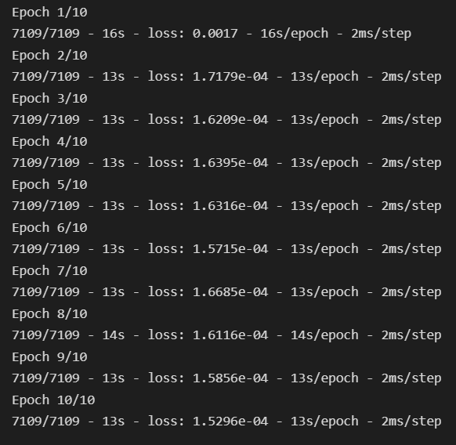
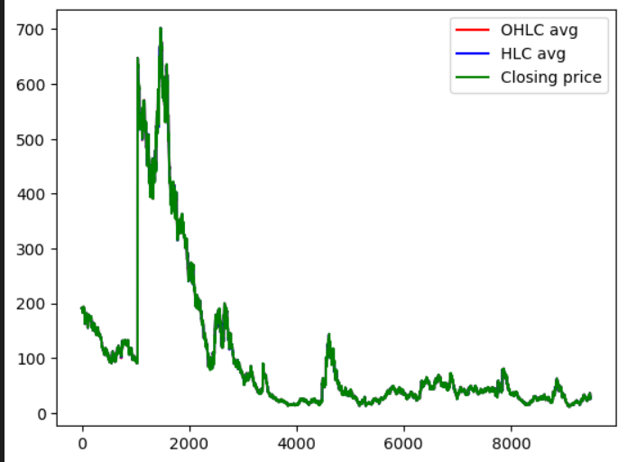
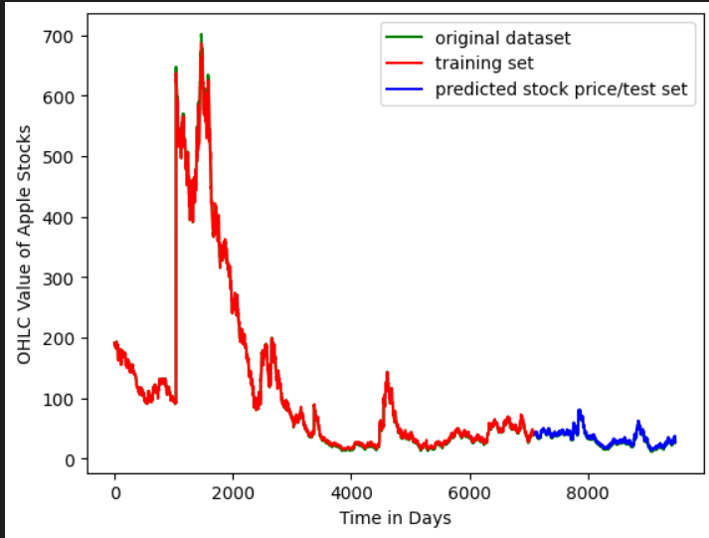
RESULT

Slide 18
CONCLUSION
By doing data pre-processing we can convert raw data into clean, understandable data and standardized data.
It will help for share Holders to predict the future.
Two of the most widely used methods, Fundamental Analysis and Technical Analysis showed little promise in the experiments carried out.
We can conclude that using this proposed method and technique we can easily and accurately predict the future price of the market.

Slide 19

Thank you

